Slide 1
Overview of Computers, Software, and Hardware
By
Mrs. Aarti S. Pardeshi

Slide 2
Types of Computers
- Mainframe computers
- Supercomputers
- Minicomputers
- Workstations
- Personal computers (Desktops, Laptops)
- Mobile devices (Smartphones, Tablets)

Slide 3
Mainframe Computers
Definition: Mainframe computers are large-scale, high-performance computers that possess immense processing power and can handle extensive data processing and storage capabilities. They are designed to support critical and resource-intensive operations in large organizations and enterprises.
characteristics
Applications : Financial institutions, Government Agencies, Healthcare industry, Airlines and transportations, Retail and E-commerce, Telecommunications
Examples of mainframe computer systems: IBMZ15, IBMZ14

Slide 4
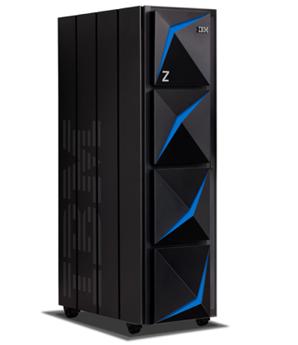
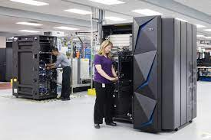
IBMZ15
IBMZ14

Slide 5
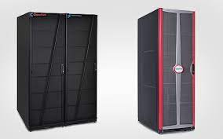
Unisys ClearPath

Slide 6
Supercomputers
Definition: A supercomputer is a high-performance computing system specifically designed to process and solve complex computational problems at an extraordinary speed.
Applications: Supercomputers are used for a wide range of applications, including scientific research, weather forecasting, climate modeling, molecular simulations, aerospace engineering, and data-intensive tasks like artificial intelligence and machine learning.
Examples of supercomputer systems: Fugaku, Summit, Piz Diant

Slide 7
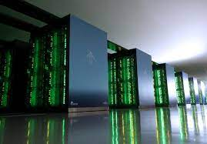
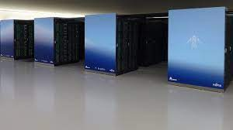
Fugaku

Slide 8
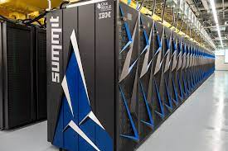
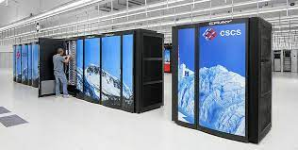
Summit
Piz Daint

Slide 9
Minicomputers
Definition: A minicomputer is a mid-sized computing system that falls between mainframe computers and microcomputers (personal computers) in terms of processing power, storage capacity, and physical size.
- Applications of minicomputers:
Minicomputers are used in Process Control and Industrial Automation, Computer-Aided Design (CAD), Educational institutions, financial institutions, LAN (for providing shared resources), Data centers for handling specific workload
- Examples of minicomputer systems: IBM system/3, Honeywell series 60, HP 2100

Slide 10
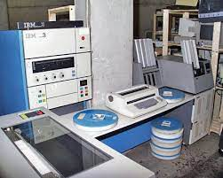
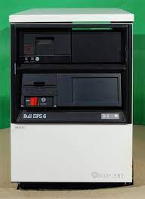
IBM System/3
Honeywell series 60

Slide 11
Workstations
Definition: A workstation refers to a specialized computer system designed for professional or technical applications that require high-performance computing capabilities.
Applications: These systems are used by professionals in fields such as engineering, architecture, graphic design, animation, scientific research, and other computationally intensive industries.
Examples of workstation systems: Dell precision, Apple Mac Pro

Slide 12
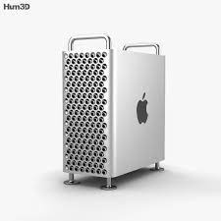
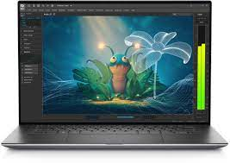
Apple Mac Pro
Dell Precision

Slide 13
Personal Computers (PCs)
Definition: A personal computer (PC) refers to a computer system designed for individual use, typically by one person at a time. PCs are intended for general-purpose computing tasks and are commonly found in homes, offices, schools, and various other settings. They are versatile machines that offer a wide range of applications and capabilities. Types of PCs (Desktops, Laptops)
Applications: They are widely used for work, education, entertainment, and communication, and their versatility makes them suitable for a wide range of applications.
- Examples of PC systems: Dell XPS, Lenovo ThinkPad, Lenovo ThinkCentre, Acer Aspire, MacBook, Asus ROG, Microsoft Surface

Slide 14
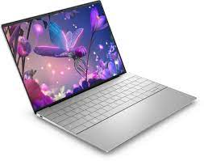
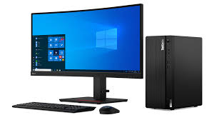
Dell XPS
Lenovo Thinkcentre

Slide 15
Mobile Devices
Definition: Mobile devices refer to portable electronic devices that are designed for on-the-go use and are capable of wireless communication. They typically have built-in batteries and offer various functionalities, including voice communication, internet browsing, multimedia playback, and access to a wide range of applications. - Types of mobile devices (Smartphones, Tablets)
- Uses and applications: Communication, Internet browsing, Entertainment and media, Productivity and organization, social media and networking
- Examples of mobile devices: Samsung M52, iPhone 14, Oneplus 11

Slide 16
Various Software Types
- System software
- Application software
- Programming software

Slide 17
System software: System software refers to a category of software that provides a foundation for a computer system to operate and manage hardware resources effectively. It acts as an intermediary between the computer hardware and the applications or user-level software.
Examples: Operating systems, Device Drivers, Firmware, Virtualization software, utility software, Language translators

Slide 18
Application Software
Definition: Application software, also known as application programs or simply applications, refers to a category of software that is designed to perform specific tasks or functions for end-users. It is developed to address various user needs and provide solutions for specific purposes, such as productivity, communication, entertainment, and more. Application software runs on top of the operating system and utilizes system resources to carry out specific tasks.
Examples (Word processors, Spreadsheets, Graphics software)

Slide 19
Categories:
1. Productivity Software: Word processors, Spreadsheets
2. Communication and Collaboration Software: Google Meet, Zoom, MS Teams
3. Multimedia Software: VLC, Adobe Photoshop, Audacity
4. Web Browsers: Chrome, Firefox, Edge
5. Entertainment and Media Software: Netflix, Spotify, Kindle
6. Education and e-Learning Software: Duolingo, Moodle, canvas
7. Utilities and Tools: Antivirus, Backup recovery softwares, Disk cleanup tools
8. Financial Software: Mint, Quicken, Xero, TurboTax, H&R block

Slide 20
Programming Software
Definition: Programming software refers to a set of tools and applications that enable developers to create, test, debug, and manage computer programs or software applications. These software tools provide an environment where developers can write, edit, and organize code, as well as perform various tasks related to software development. Programming software helps streamline the development process and assists programmers in writing efficient and error-free code.
Examples: IDEs, Compilers

Slide 21
Programming Software
Examples:
Integrated Development Environments (IDEs): Visual Studio, Eclipse, Xcode, and IntelliJ IDEA
Code Editors: Notepad++, Visual Studio Code, Sublime Text
Compilers and Interpreters: C, C++, Java, Python
Version Control Systems: Git, SVN (Subversion), and Mercurial
Debugging Tools
Software Libraries and Frameworks: React.js, TensorFlow, jQuery
Testing Tools

Slide 22
Various Types of Hardware
- Central Processing Unit (CPU)
- Memory (RAM, ROM)
- Storage devices (Hard drives, Solid-state drives)
- Input devices (Keyboard, Mouse)
- Output devices (Monitor, Printer)

Slide 23
Central Processing Unit (CPU):
CPU stands for Central Processing Unit. It is often referred to as the "brain" of a computer or electronic device. The CPU is a hardware component responsible for executing instructions and performing calculations necessary for the operation of a computer system.

Slide 24
Here are some key points about CPUs:
Function: The CPU performs the essential processing tasks in a computer system, such as executing instructions, performing arithmetic and logical operations, and managing data flow between different components.
Core Components: A CPU typically consists of one or more processing cores, each capable of executing instructions independently. Modern CPUs often have multiple cores, allowing for parallel processing and improved performance.

Slide 25
Cache: CPUs often have various levels of cache memory, which is faster to access than main memory (RAM). The cache stores frequently accessed data and instructions, reducing the time needed to fetch them from RAM.
Instruction Set Architecture (ISA): The CPU's instruction set architecture defines the set of instructions it can understand and execute. Popular ISAs include x86 (used by Intel and AMD processors), ARM (common in mobile devices), and RISC-V (an open-source ISA).

Slide 26
Heat Dissipation: CPUs generate heat while in operation, and cooling systems such as fans or heat sinks are used to dissipate this heat to prevent overheating.
Multithreading: Modern CPUs often support multithreading, allowing each core to handle multiple threads simultaneously. This technology enhances performance and allows for improved multitasking and parallel processing.

Slide 27
Instruction Execution: The CPU fetches instructions from memory, decodes them, and then executes them. It carries out a wide range of operations, including arithmetic calculations, logical comparisons, data manipulation, and control flow operations.
Clock Speed: The clock speed of a CPU, measured in gigahertz (GHz), determines how many instructions it can execute per second. Higher clock speeds generally result in faster processing, although other factors such as architecture and efficiency also play a role.
Compatibility: Different CPUs have varying compatibility with software and operating systems. Software applications and operating systems are often compiled or optimized for specific CPU architectures or instruction sets.

Slide 28
Memory
Types of memory (RAM, ROM)
RAM stands for Random Access Memory, is a crucial component of a computer system's memory hierarchy. It is a type of volatile memory that stores data and instructions that the CPU actively uses during program execution. RAM provides fast and temporary storage for data that the CPU needs to access quickly, improving the overall performance of the system.
RAM plays a vital role in computer systems, facilitating the smooth and efficient execution of programs and tasks. It acts as a temporary workspace for the CPU, allowing it to store and access data quickly. The amount of RAM a system has can significantly impact its multitasking capabilities, overall performance, and responsiveness.

Slide 29
ROM stands for Read-Only Memory, is a type of non-volatile memory that stores data and instructions permanently. Unlike RAM, ROM retains its contents even when the power to the computer or device is turned off. The data stored in ROM cannot be modified or erased by normal computer operations, hence the term "read-only.“
ROM provides a means of storing permanent data and instructions in computer systems and electronic devices. It is critical for the initial boot process, firmware storage, and storing other crucial data that needs to be preserved over time.

Slide 30
Variants of ROM: There are different variants of ROM with varying characteristics:
Mask ROM (MROM): This type of ROM is programmed during the manufacturing process using a photolithographic mask. Once programmed, the data is permanently embedded in the ROM, and it cannot be changed.
PROM (Programmable ROM): PROM can be electrically programmed once by the user or manufacturer after the device is manufactured. It uses fuses or programmable links to store data permanently.
EPROM (Erasable Programmable ROM): EPROM allows data to be erased and reprogrammed using ultraviolet (UV) light exposure. This erasure is done using a special EPROM eraser device, enabling reprogramming of the ROM.
EEPROM (Electrically Erasable Programmable ROM): EEPROM allows data to be erased and reprogrammed electrically. Unlike EPROM, EEPROM can be erased and reprogrammed on a byte-by-byte basis without requiring UV light exposure.

Slide 31
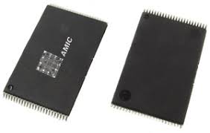
Mask ROM (MROM):

Slide 32
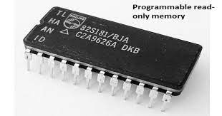
PROM (Programmable ROM)

Slide 33
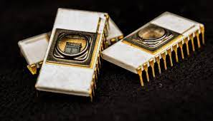
EPROM (Erasable Programmable ROM)

Slide 34
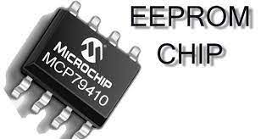

Slide 35
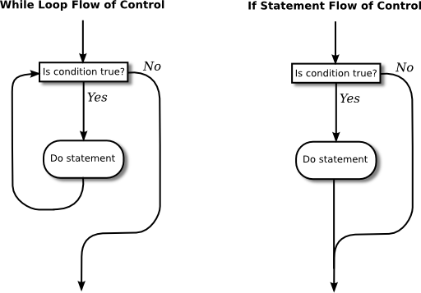
Control Structure

Slide 36
An algorithm is a well-defined, step-by-step procedure or set of rules used to solve a problem or perform a specific task. It is a precise and unambiguous set of instructions that outlines the logical sequence of operations needed to achieve a desired outcome. Algorithms are used in various fields, including computer science, mathematics, and problem-solving domains.

Slide 37
Here are some key points about algorithms:
Problem Solving: Algorithms are designed to solve specific problems or accomplish specific tasks. They provide a systematic approach to breaking down a problem into smaller, manageable steps that can be executed sequentially.
Sequence of Steps: An algorithm consists of a series of well-defined steps or operations. Each step represents a specific action or calculation to be performed to move closer to the desired solution or outcome.

Slide 38
Input and Output: Algorithms take input, which can be data, variables, or other information, and produce output, which is the result or solution of the problem. The input is processed through the series of steps, and the output is generated based on the algorithm's logic.
Unambiguous and Deterministic:
Efficiency: The efficiency of an algorithm refers to its ability to solve a problem using the fewest possible steps or operations. Efficiency considerations include factors such as time complexity (how long it takes to execute) and space complexity (how much memory it requires).

Slide 39
Pseudocode and Flowcharts: Algorithms can be described using pseudocode or flowcharts, which are not tied to any specific programming language. These visual or textual representations help communicate the logic and structure of the algorithm.
Iteration and Control Structures: Algorithms often involve repetition (iteration) and decision-making (control structures) to handle different scenarios or conditions. Loops, conditionals, and other control structures are used to control the flow of execution within an algorithm.
Design and Analysis: Algorithm design involves creating an efficient and effective solution for a problem. Algorithm analysis involves evaluating the efficiency and correctness of an algorithm.

Slide 40
Algorithm: Exchange Values with Temporary Variable
Input: Two variables `a` and `b`
Output: Updated values of `a` and `b`
1. Create a temporary variable `temp` and assign it the value of `a`.
2. Assign the value of `b` to `a`.
3. Assign the value of `temp` to `b`.
4. Output the updated values of `a` and `b`.

Slide 41
Reference : http://program-art.blogspot.com/2014/06/swapping-of-two-number.html

Slide 42
Example: Exchange Values with Temporary Variable
a= 3 and b = 4
temp = a means temp =3
a = b means a=4
b = temp means b = 3

Slide 43
Algorithm: Exchange Values without Temporary Variable
Input: Two variables `a` and `b`
Output: Updated values of `a` and `b`
1. Assign the sum of `a` and `b` to `a`.
2. Assign the difference between the new `a` value and the original `b` value to `b`.
3. Assign the difference between the new `a` value and the new `b` value to `a`.
4. Output the updated values of `a` and `b`.

Slide 44
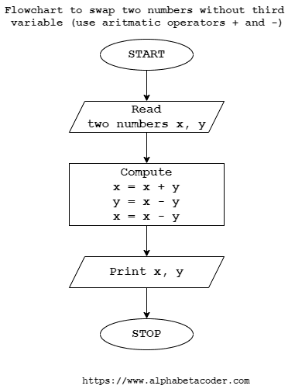
X = 30
Y = 40
X + Y = 70
X = X + Y
X = 70
X – Y = 70 – 40
X – Y = 30
Y = X - Y
Y = 30
X – Y = 70 – 30
X – Y = 40
X = X – Y
X = 40
AND Y =30
Reference: www.alphabetcoder.com

Slide 45
An algorithm to count positive integers from a given set:
1. Initialize a variable `count` to 0.
2. Iterate through each element in the given set.
3. For each element:
- Check if it is a positive integer.
- If the element is positive then increment the `count` variable by 1.
4. Once you have checked all the elements in the set, the `count` variable will hold the total number of positive integers.
5. Output the value of the `count` variable.

Slide 46
An algorithm to calculate the sum of a set of numbers:
Initialize a variable sum to 0.
Iterate through each element in the set of numbers.
For each element: Add the element to the sum variable.
Once you have iterated through all the elements in the set, the sum variable will hold the summation of the numbers.
Output the value of the sum variable.

Slide 47
An algorithm to reverse the digits of an integer:
Initialize a variable reversed_num to 0.
While the input integer is not equal to 0:
Extract the last digit of the input integer using the modulo operator (%) by taking the remainder of dividing it by 10.
Multiply the reversed_num variable by 10 and add the extracted digit to it.
Divide the input integer by 10, discarding the last digit.
Once the input integer becomes 0, the reversed_num variable will hold the reversed digits of the original integer.
Output the value of the reversed_num variable.

Slide 48
A step-by-step procedure to reverse the digits of the number 1234 using the modulo operator:
1. Start with the number 1234.
2. Initialize a variable reversed_num to 0, which will hold the reversed digits.
3. Extract the last digit of the number by taking the remainder of number by dividing it by 10:
last_digit = 1234 % 10 = 4.
4. Multiply the reversed_num by 10 and add the extracted digit to it: reversed_num = (0 * 10) + 4 = 4.
5. Divide the original number by 10, discarding the last digit: 1234 = 123.

Slide 49
6. Extract the last digit: last_digit = 123 % 10 = 3.
7. Update the reversed_num: reversed_num = (4 * 10) + 3 = 43.
8. Divide the original number: 123 = 12.
9. Extract the last digit: last_digit = 12 % 10 = 2.
10. Update the reversed_num: reversed_num = (43 * 10) + 2 = 432.

Slide 50
11. Divide the original number: 12 = 1.
12. Extract the last digit: last_digit = 1 % 10 = 1.
13. Update the reversed_num: reversed_num = (432 * 10) + 1 = 4321.
14. Divide the original number: 1 = 0.
The original number becomes 0, and the reversed_num holds the reversed digits of the original number.
The reversed number is 4321.
Therefore, the step-by-step procedure using the modulo operator to reverse the digits of 1234 is:
1234 → 4 → 43 → 432 → 4321.

Slide 51
☺ ☺ Thank you ☺ ☺

